Slide 1
IEEE Day 2017
Saida Maaroufi
Vice-chair of IEEE WIE Montreal
Concordia University
Tuesday 3 October 2017, 6:00 pm to 9:00 pm

Slide 2
Plan
Introduction
IEEE WIE Montreal Team Members
IEEE WIE 2017 Activities
My experience with IEEE
Conclusion

Slide 3
Introduction

Slide 4
Introduction
Objective:
Promote women engineers and scientists and inspire girls to get involved in engineering programs;
→ IEEE WIE Montreal organizes events and seminars in order to highlight the contribution and achievements of women in leadership positions and take benefit of networking opportunities to inspire and learn from each other's experiences.

Slide 5
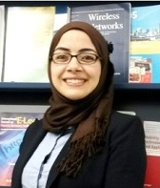
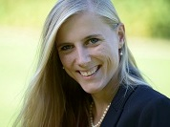
IEEE WIE Team Members
Dr. Saida Maaroufi
Prof. Milica Popovich
Ms. Lena Kranold
Vice-chair of IEEE WIE Montreal
Chair of IEEE WIE Montreal
Treasurer of IEEE WIE Montreal
➔IEEE WIE Montreal webpage: http://www.polymtl.ca/IEEEWIEMontreal/index.html

Slide 6
IEEE WIE 2017 Activities
Women In STEM (in Collaboration with TouchTunes) on March 16th to celebrate women’s day:
Highlight the contribution of women leaders in Science, Technology, Engineering and Mathematics (STEM)
Stimulate discussions and debating on the issues related to the implication of women in STEM fields;
Develop leadership competencies through useful and valuable advice of professional career coaches.
Speaker 1: Dr. Amy Pinchuk, Chair of IEEE Montreal Section, InField Scientific Inc.
Speaker 2: Dr. Rana Farah, Computer Vision Scientist, Polytechnique Montreal.
Speaker 3: Mrs. Petula Guimaraes, Associate Producer at TouchTunes Interactive Networks.
Speaker 4: Mrs. Meriem Mendili, President and Founder of Coach PNL sans frontières Inc.

Slide 7
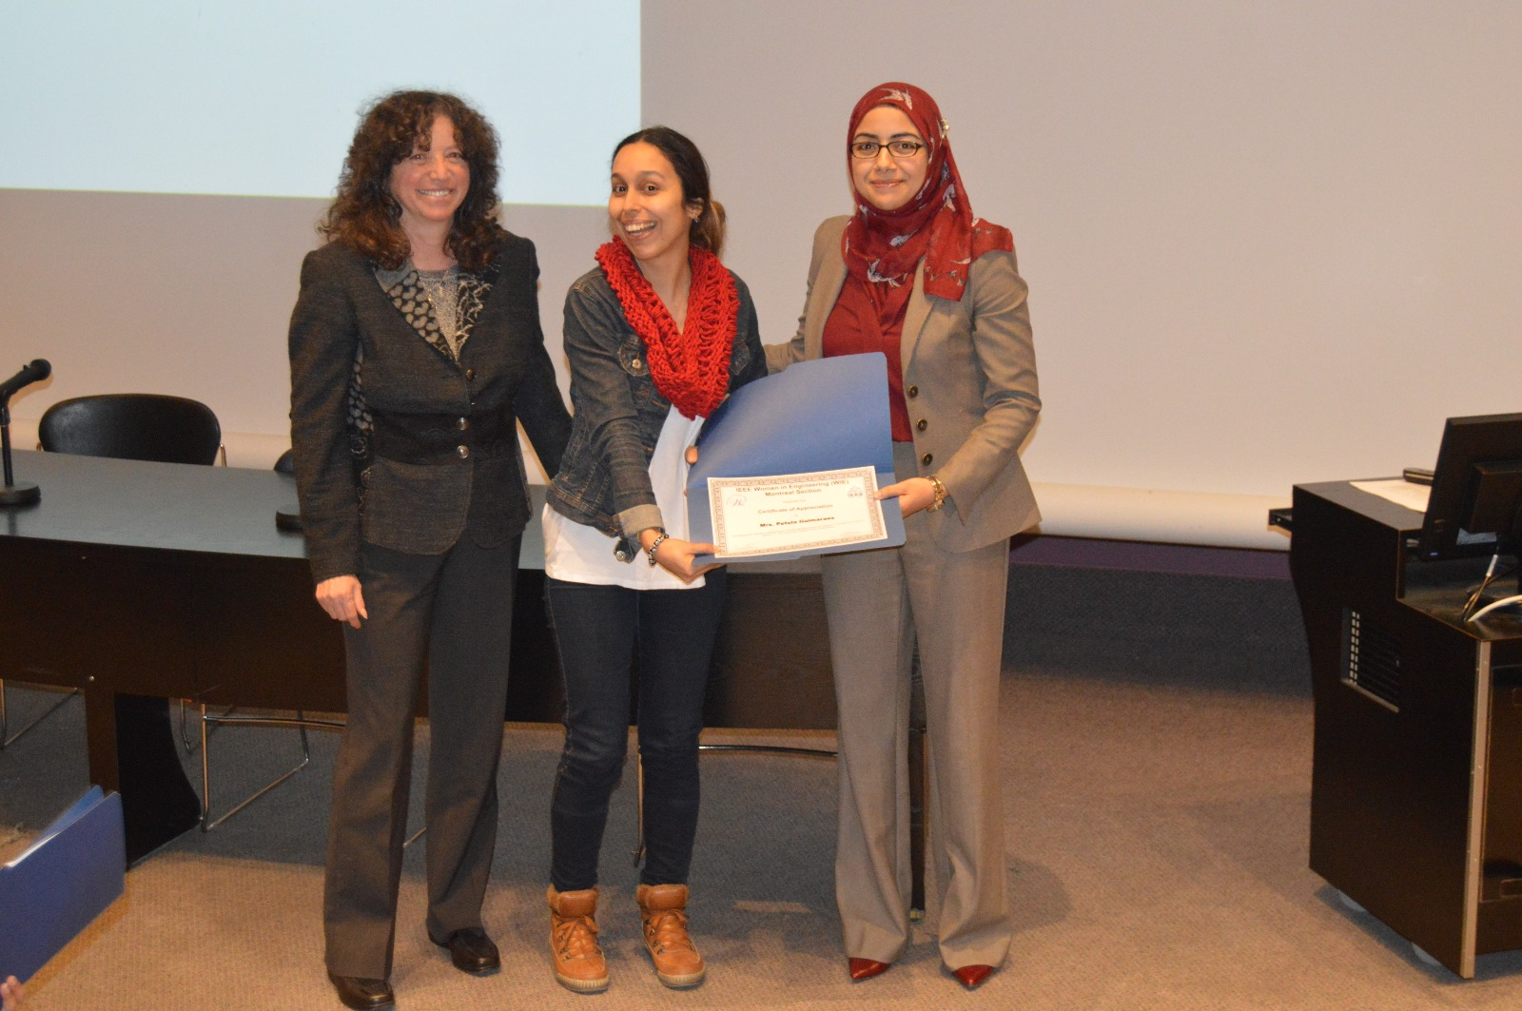
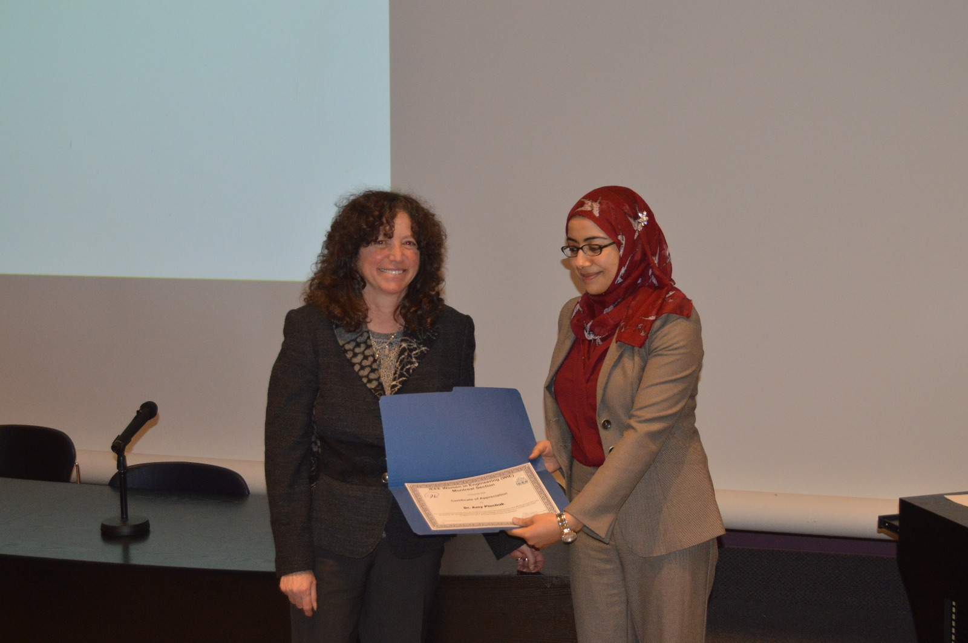
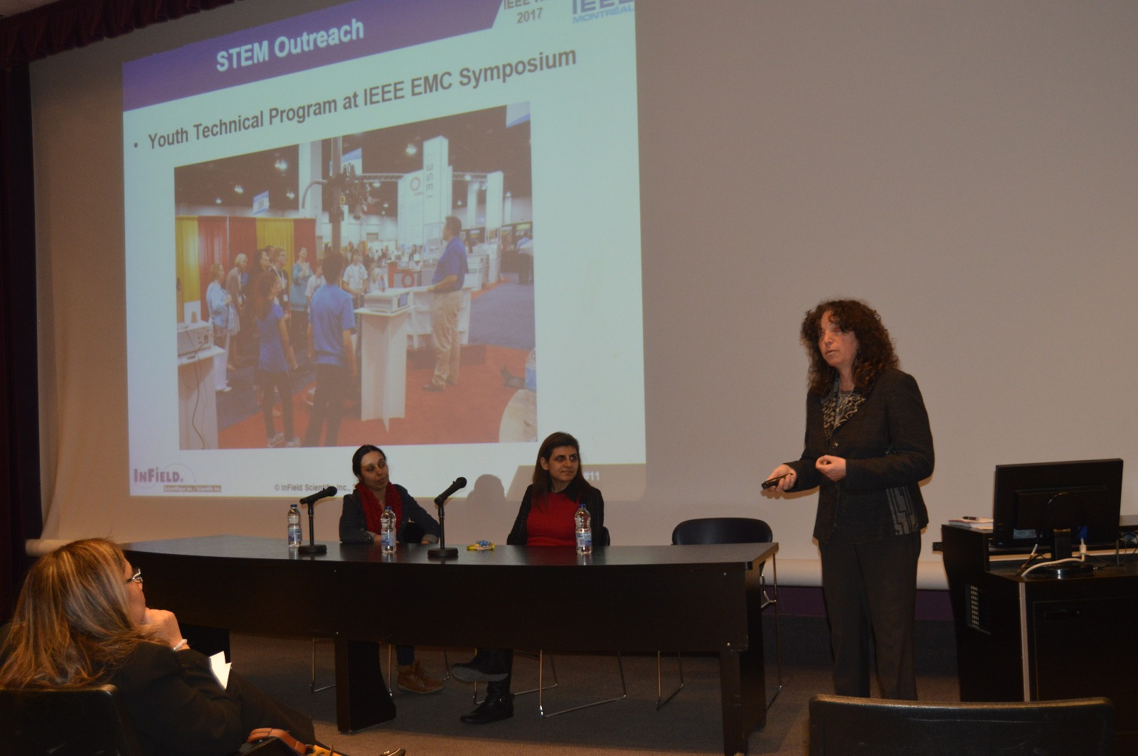
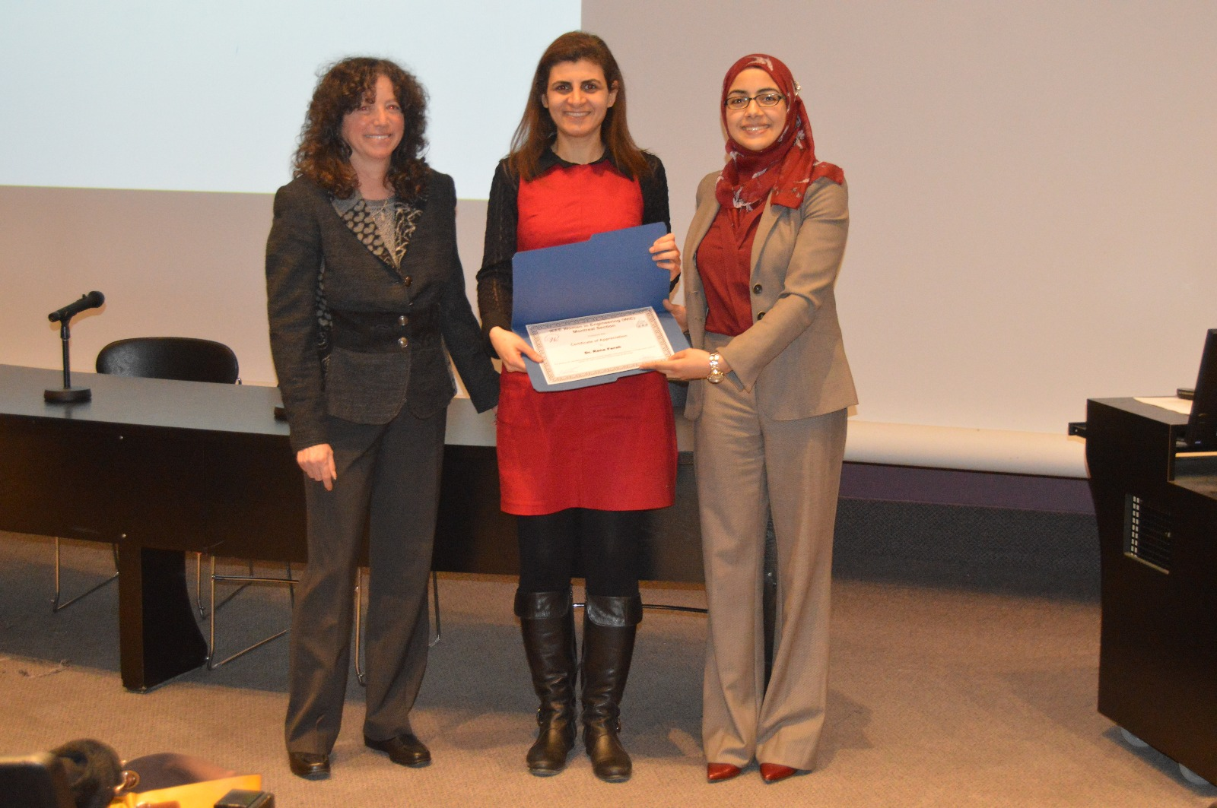
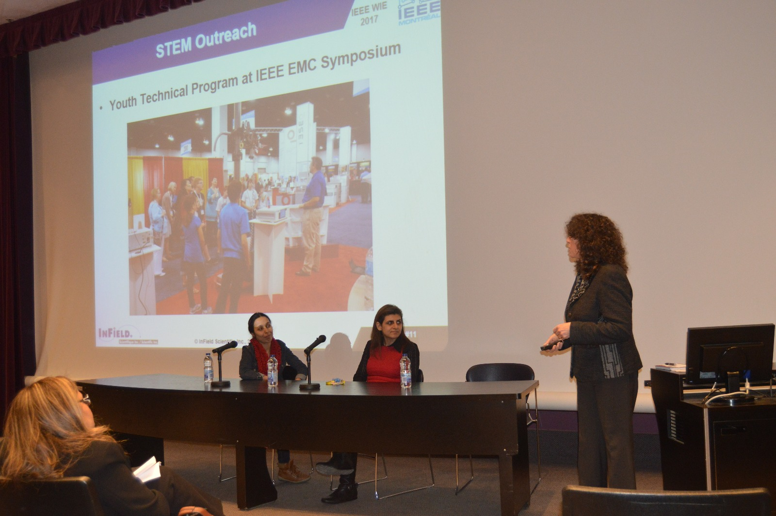

Slide 8
IEEE WIE 2017 Activities
Close to the Patient and Close to Market Seminar (May 30th, 2017)
The development of medical technologies and the challenges posed by bringing these devices to market;
Highlight the contribution of women in the development of medical technologies.
Speaker 1: Prof. Milica Popović, Chair of IEEE WIE Montreal Section, McGill University
Speaker 2: Dr. Emily Porter, Marie-Curie ASSISTID Fellow, National University of Ireland Galway
Speaker 3: Dr. Adam Santorelli, Postdoctoral Researcher, National University of Ireland Galway

Slide 9
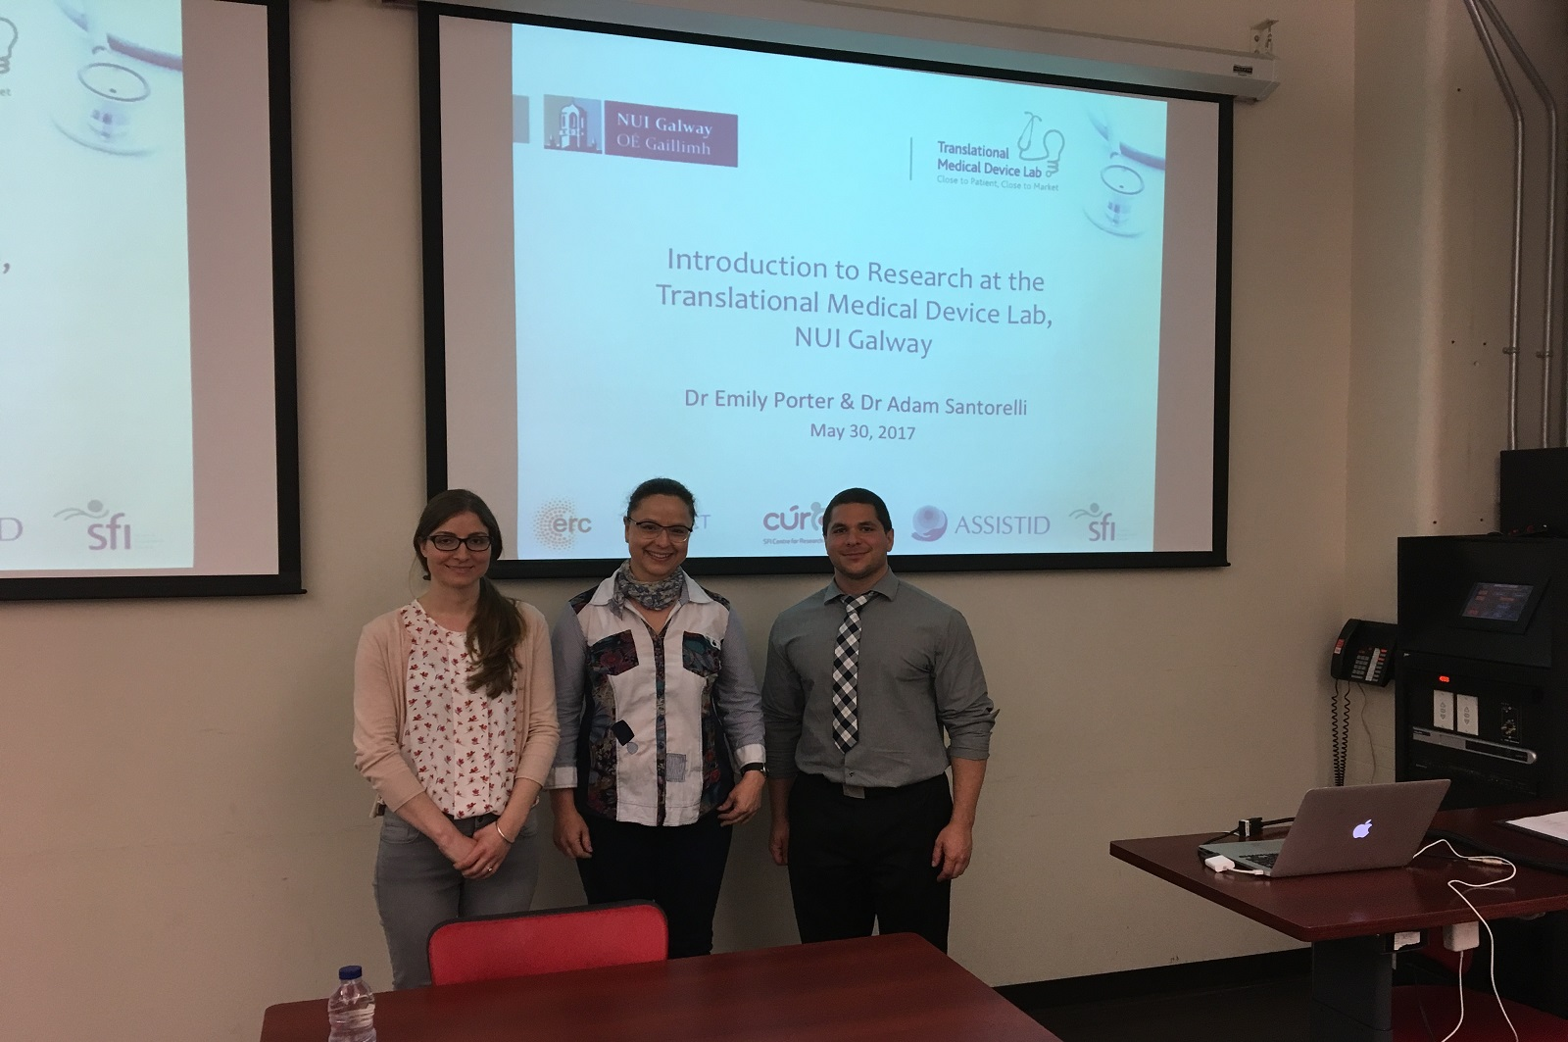

Slide 10
IEEE WIE 2017 Activities
Microwave Imaging Seminar (August 23rd)
Give their view of progress in microwave imaging, their experience as women engineers and remark on academic work in their Canadian and European research environments
Speaker 1: Prof. Raquel Conceição, Assistant Professor, Universidade de Lisboa, Portugal.
Speaker 2: Prof. Natalia Nikolova, Professor, McMaster University.

Slide 11
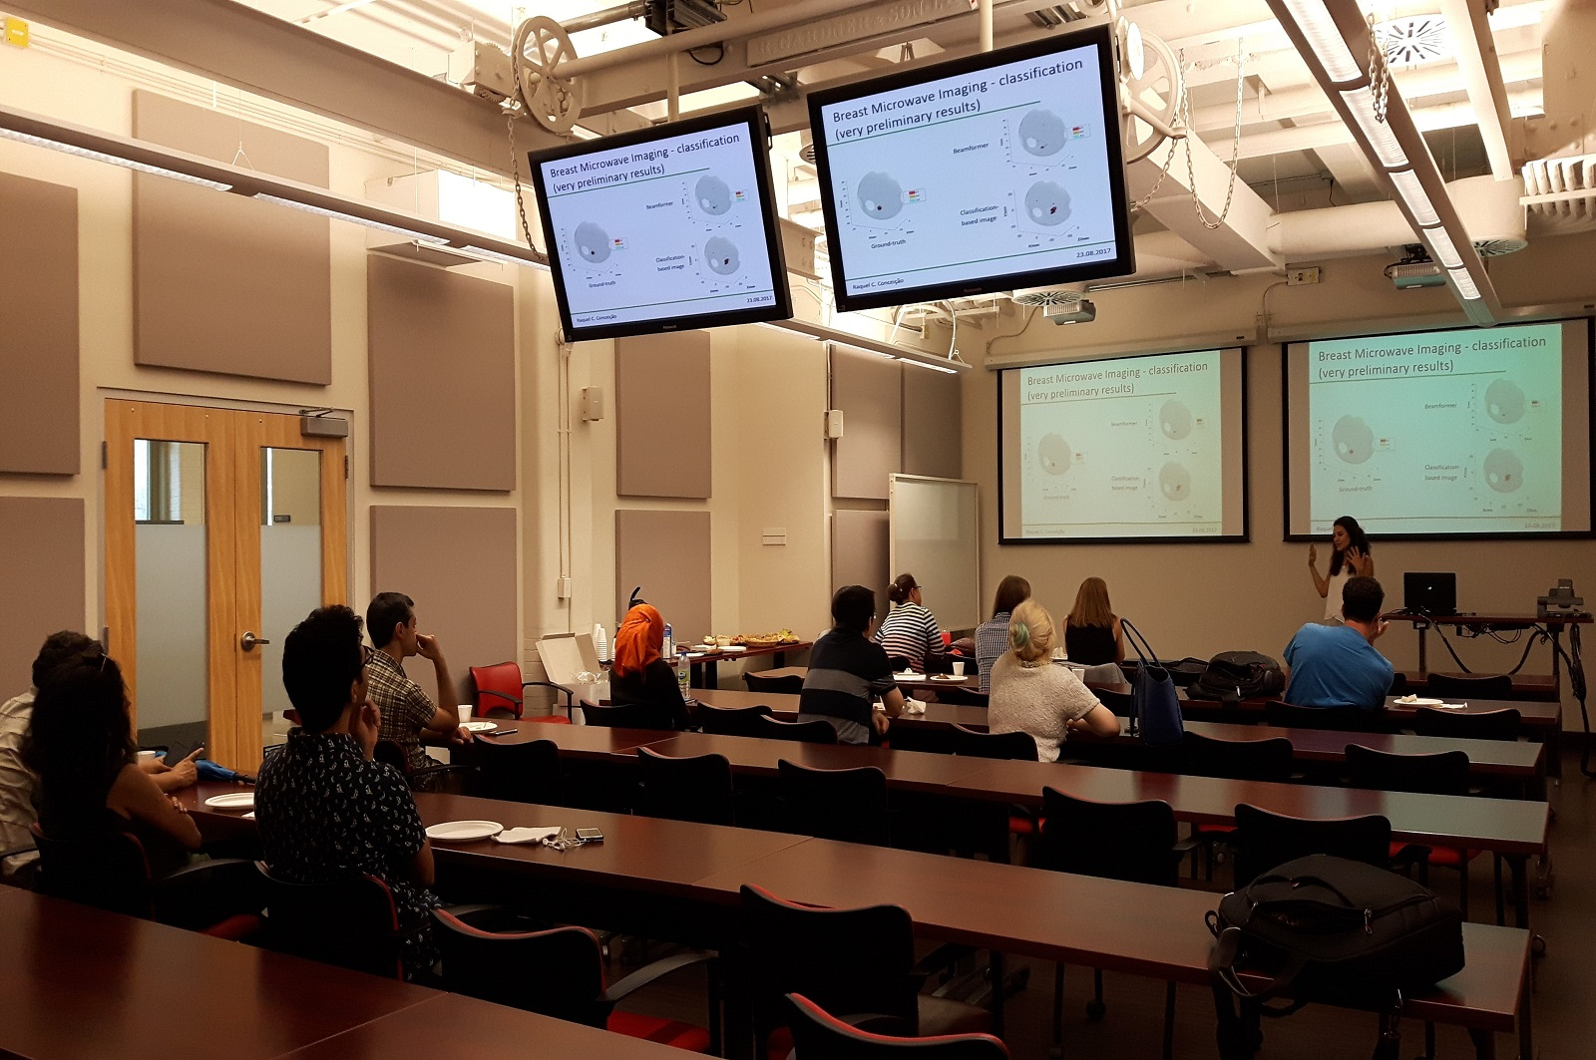
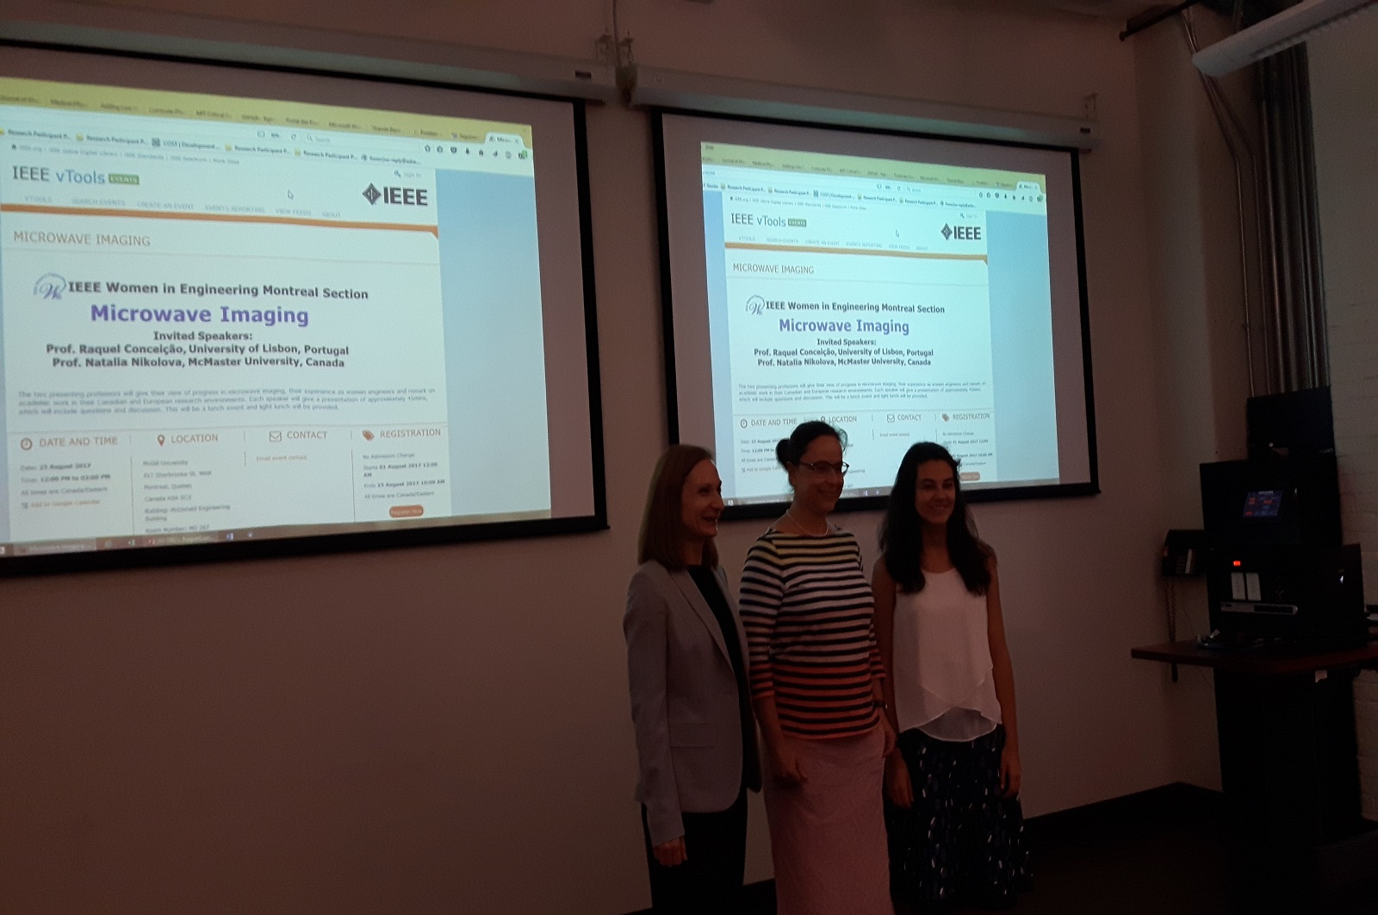

Slide 12
IEEE WIE 2017 Activities
Dielectric Resonator Antennas: From microwaves to optical frequencies Seminar on (October 13th, 2017)
Speaker: Prof. Christophe Fumeaux, Professor, University of Adelaide, Australia
Women in Computing: Mobile Applications Development Seminar on (November 10th, 2017) in conjunction with TouchTunes.

Slide 13
Conclusion
We are always happy to hear from you
Please feel free to contact us if you are interested in collaboration or in giving a talk (ieeewiemtl@gmail.com)
IEEE WIE Montreal webpage: http://www.polymtl.ca/IEEEWIEMontreal/index.html

Slide 14
Thank you for your attention! IEEE WIE Montreal

